Slide 1
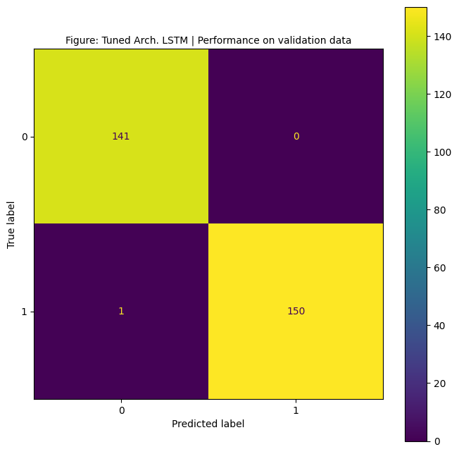
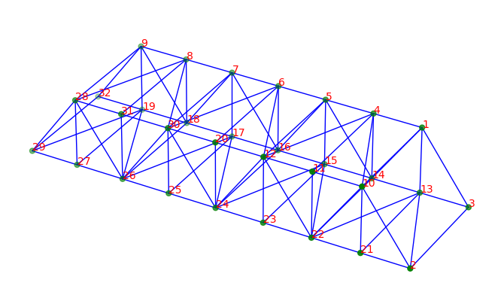
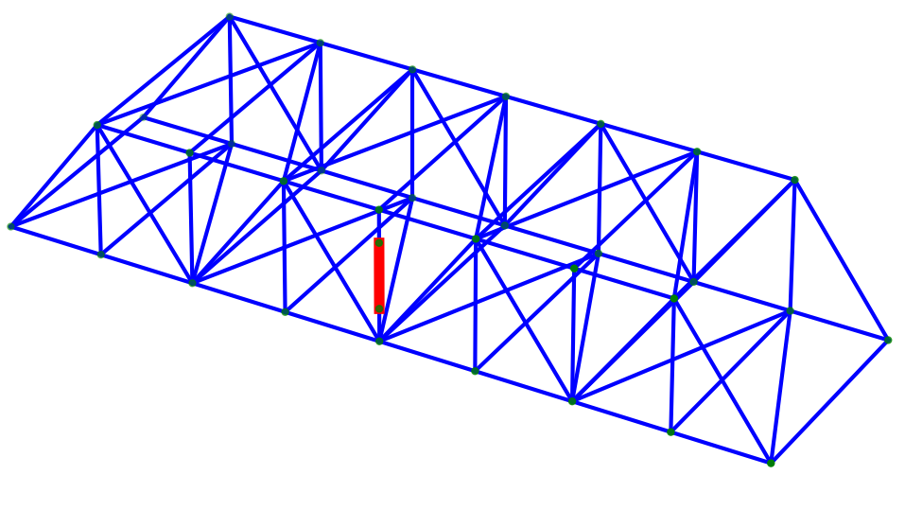
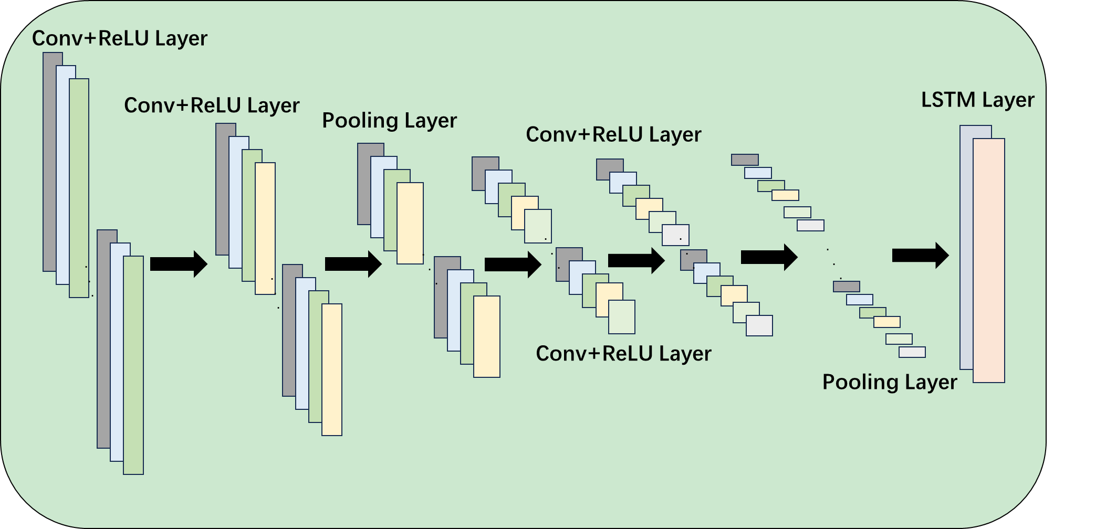
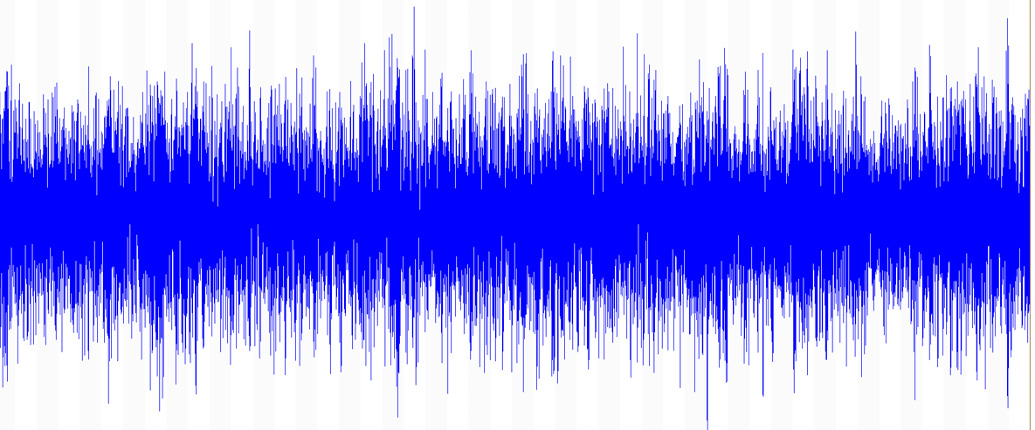
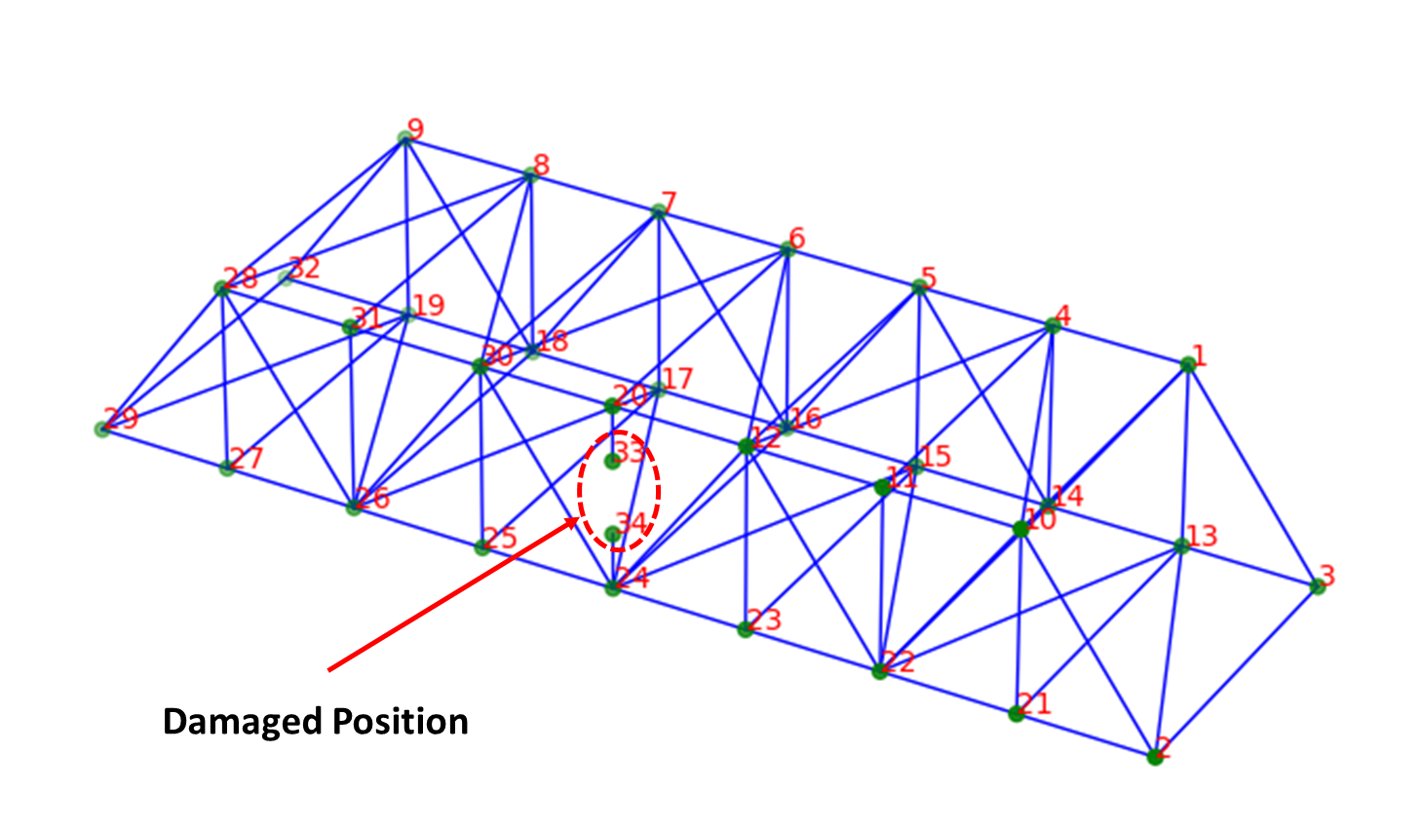
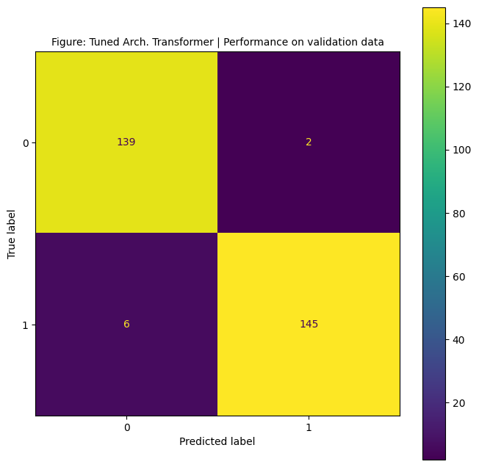
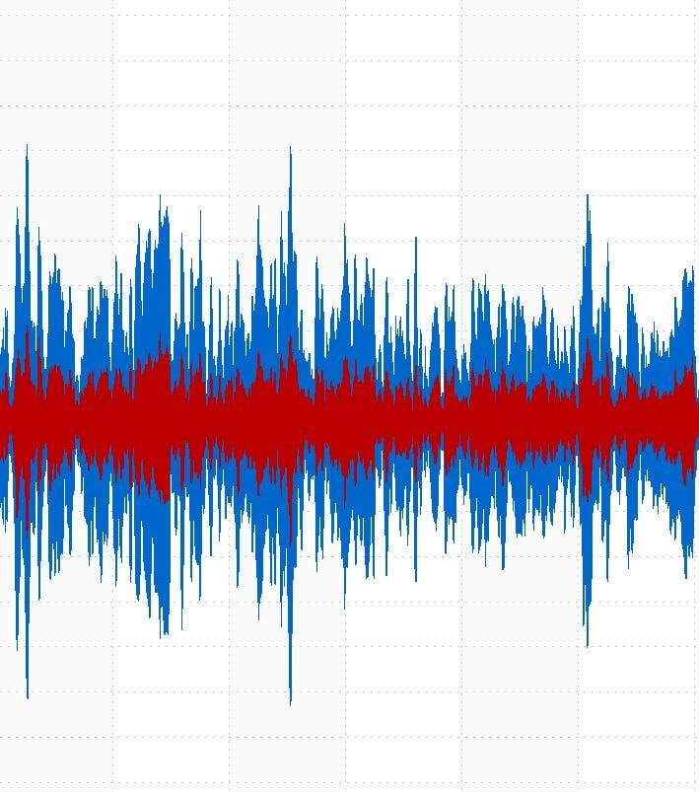
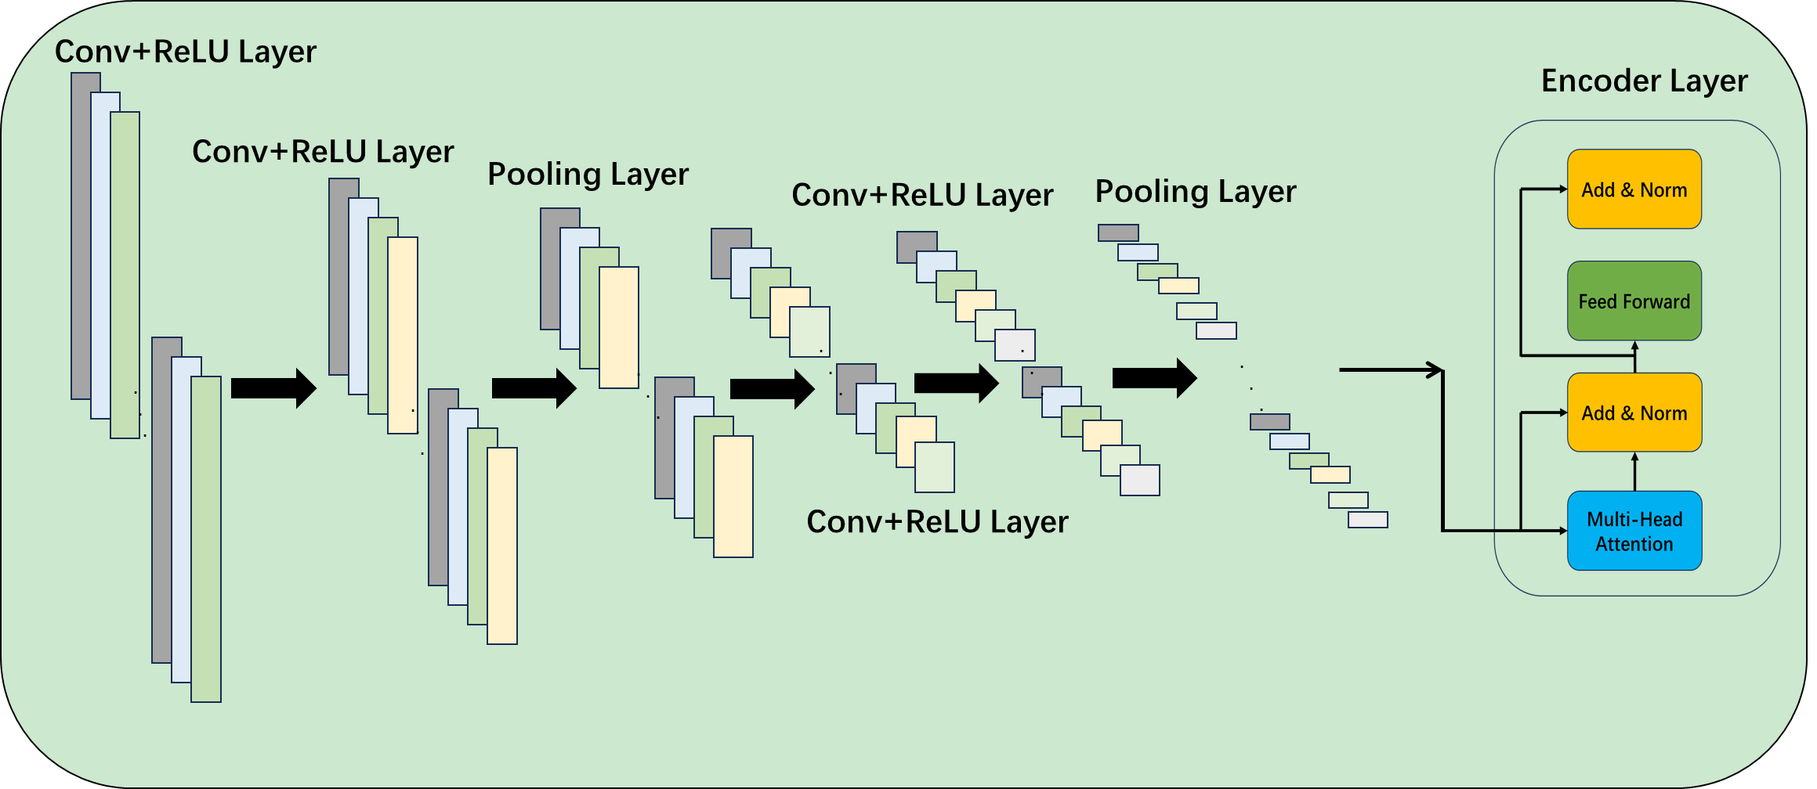

Intact Bridge DT
Vibration Signal
CNN+LSTM
Tuned CNN+LSTM
Training
Bayesian Optimization
Excitation Force
Result
Tuned CNN+Transformers
Training
Bayesian Optimization
Damaged Bridge DT
CNN+Transformers

Slide 2
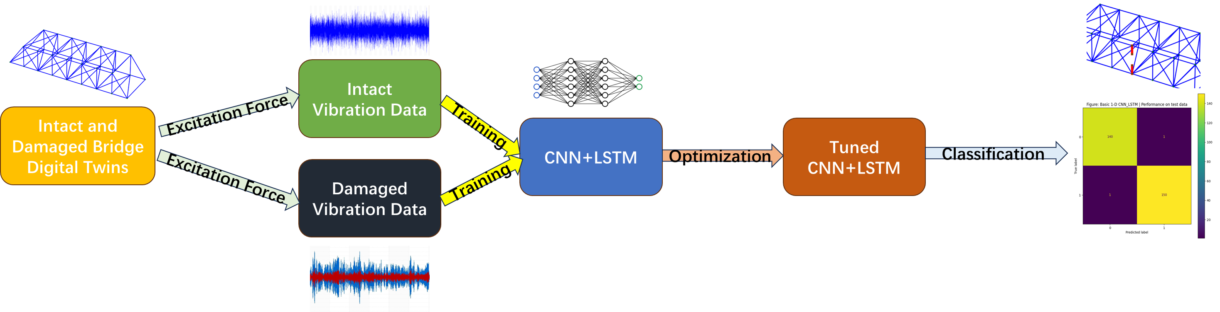

Slide 3
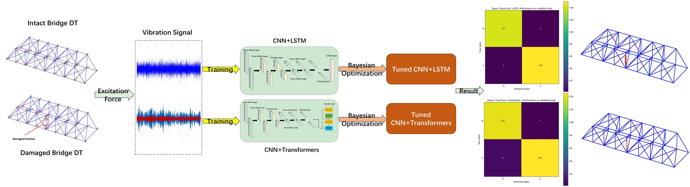

Slide 4
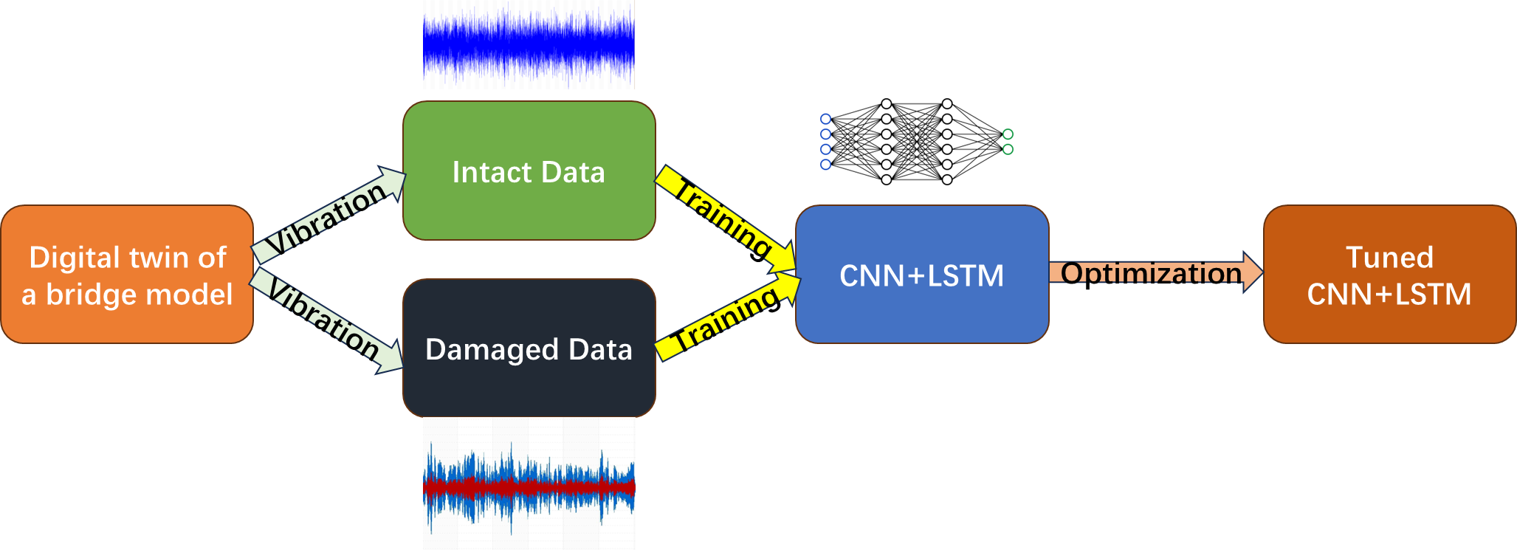

Slide 5
Conv+ReLU Layer
Input Data
Number of channel
Conv+ReLU Layer
LSTM Layer
FC Layer
Output Layer
Pooling Layer
Conv+ReLU Layer
…
Number of data
…
.
.
.
.
.
.
.
.
.
.
.
.
.
.
.
.
.
.
.
.
.
Conv+ReLU Layer
…
Pooling Layer
Length of data
Feature extractor
Classifier

Slide 6
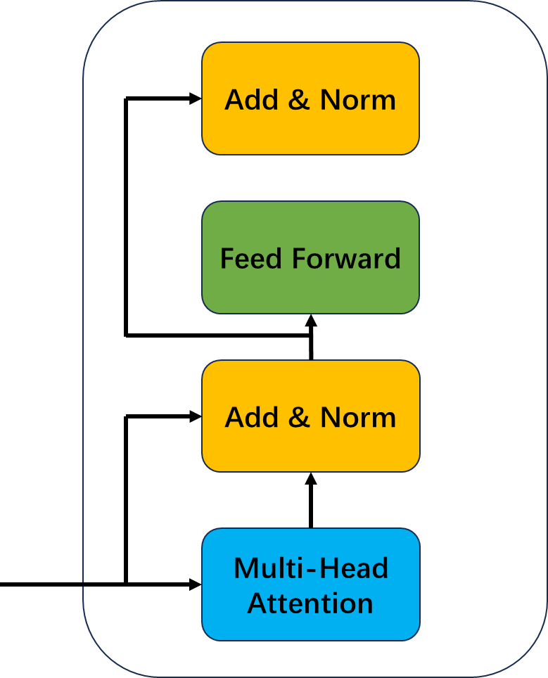
Conv+ReLU Layer
Input Data
Encoder Layer
Number of channel
Conv+ReLU Layer
FC Layer
Output Layer
Pooling Layer
Pooling Layer
Conv+ReLU Layer
…
Number of data
…
.
.
.
.
.
.
.
.
.
.
.
.
.
.
.
.
.
.
.
.
.
Conv+ReLU Layer
…
Length of data
Feature extractor
Classifier

Slide 7
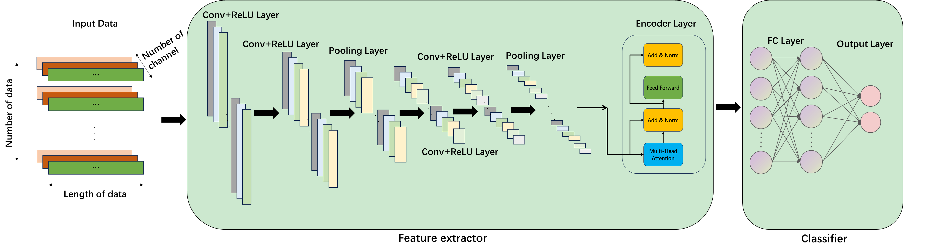

Slide 8
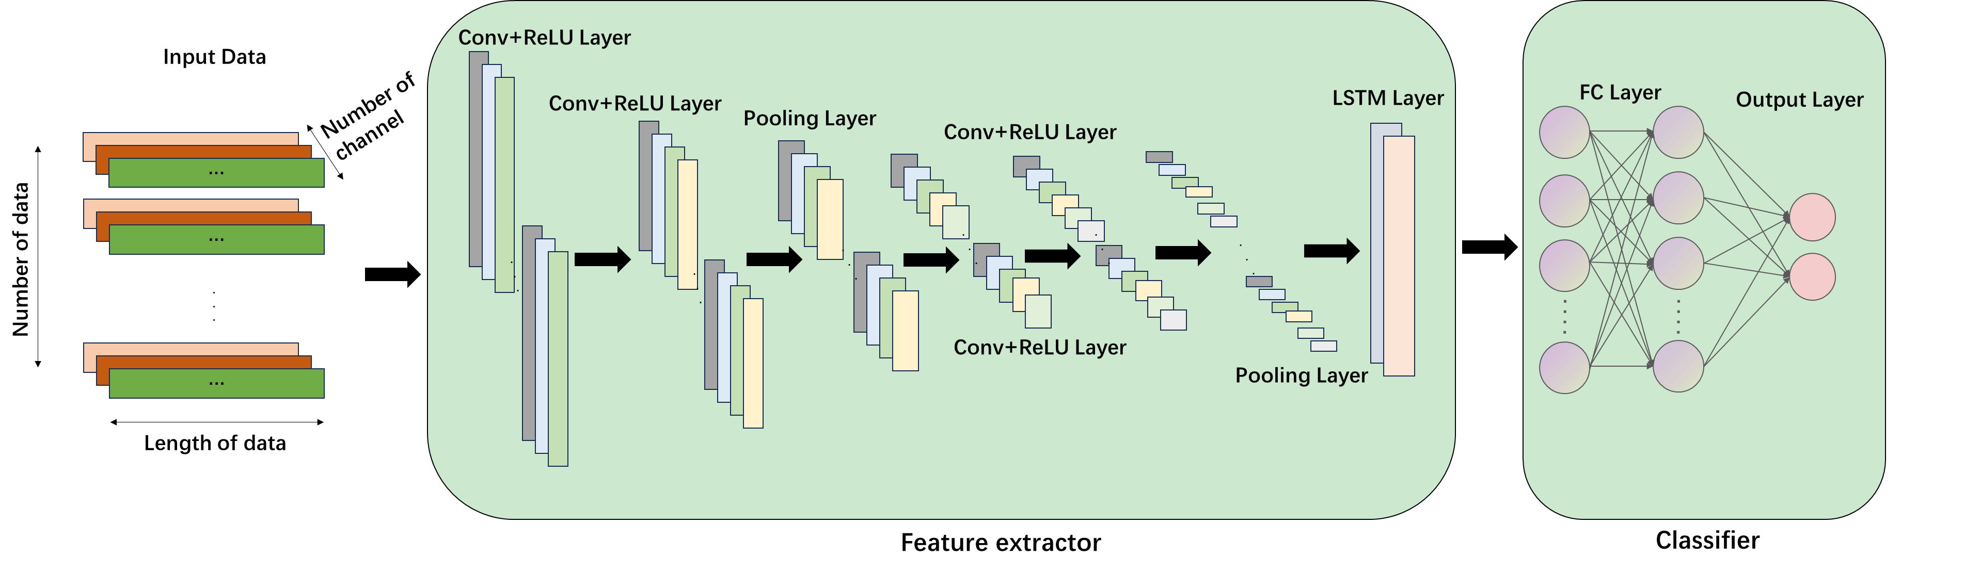

Slide 9
Add & Norm
Feed Forward
Add & Norm
Multi-Head
Attention

Slide 10
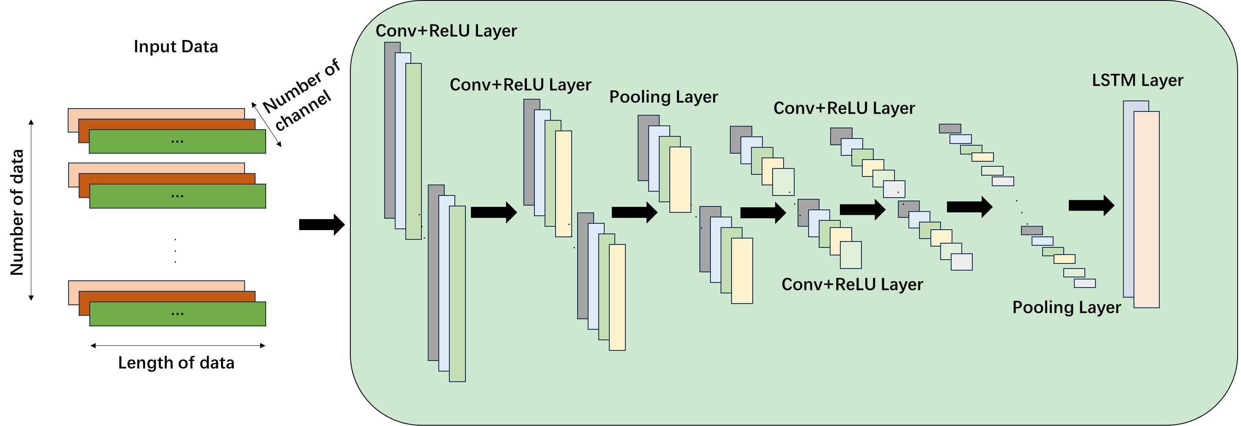

Slide 11
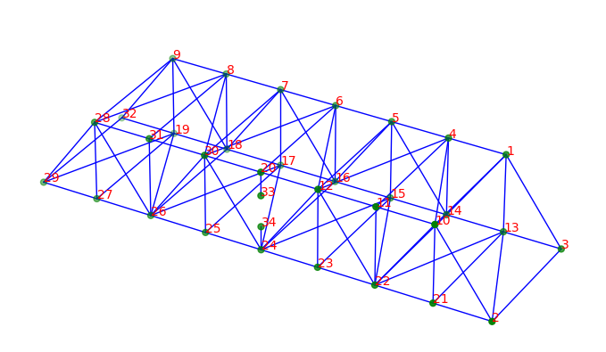
Damaged Position

